Slide 1
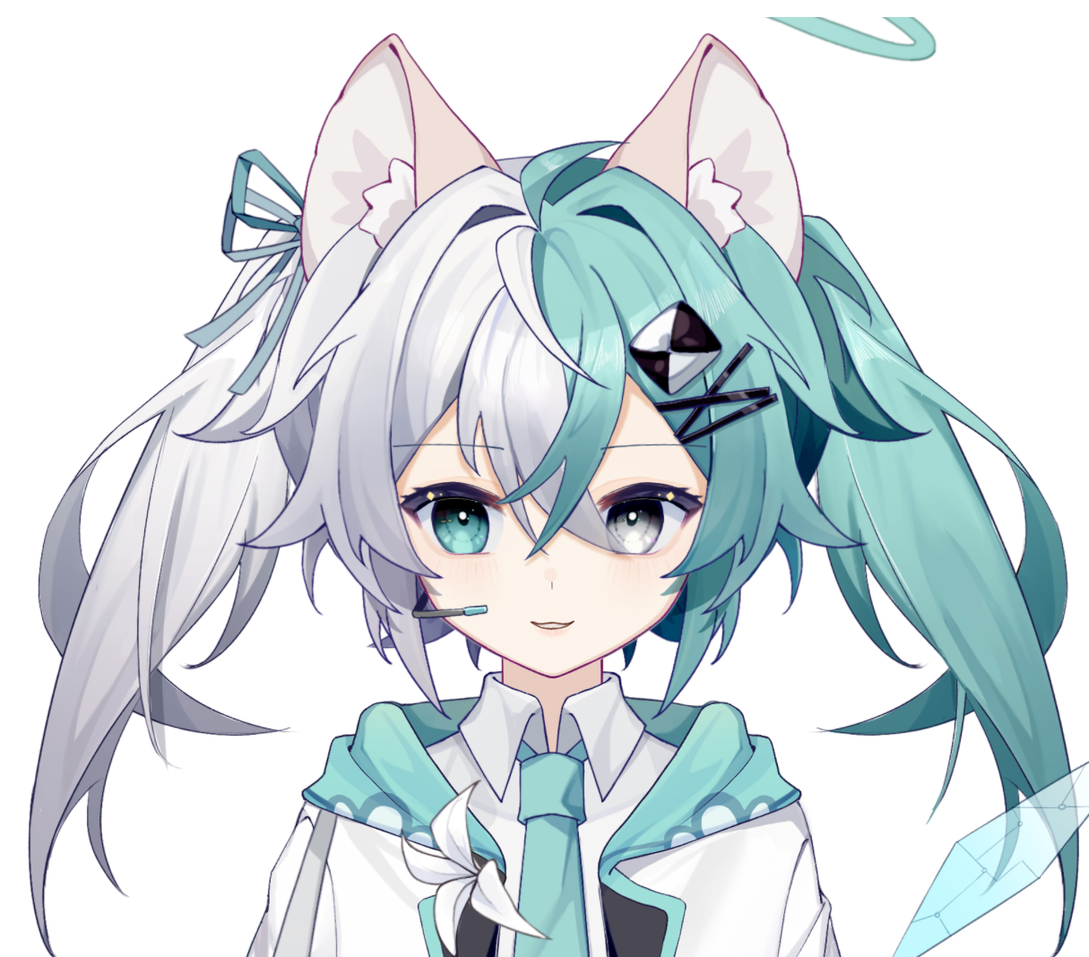


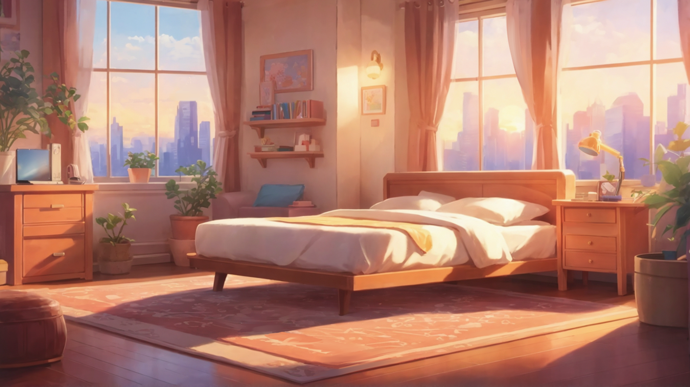
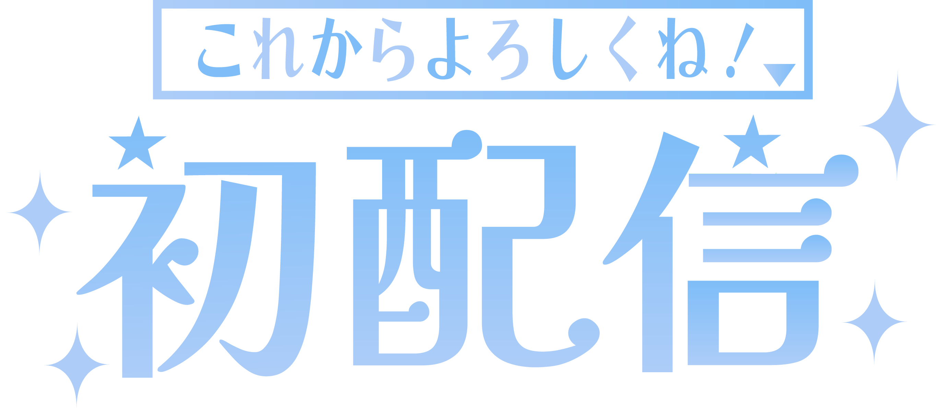

Slide 2


Slide 4


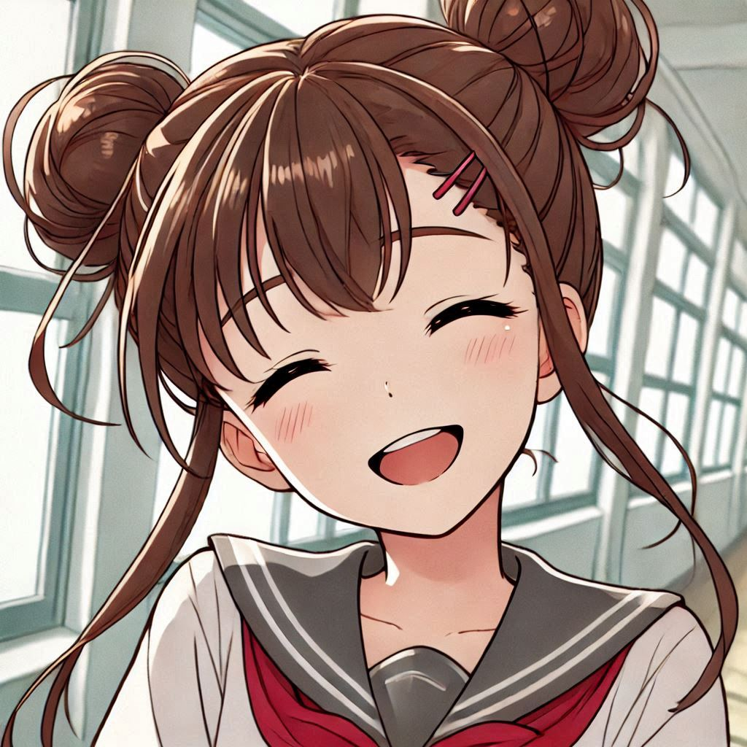
Aim
Notes:
a Japanese anime-style girl with brown hair tied up as two top knot, happily smiling

Slide 5
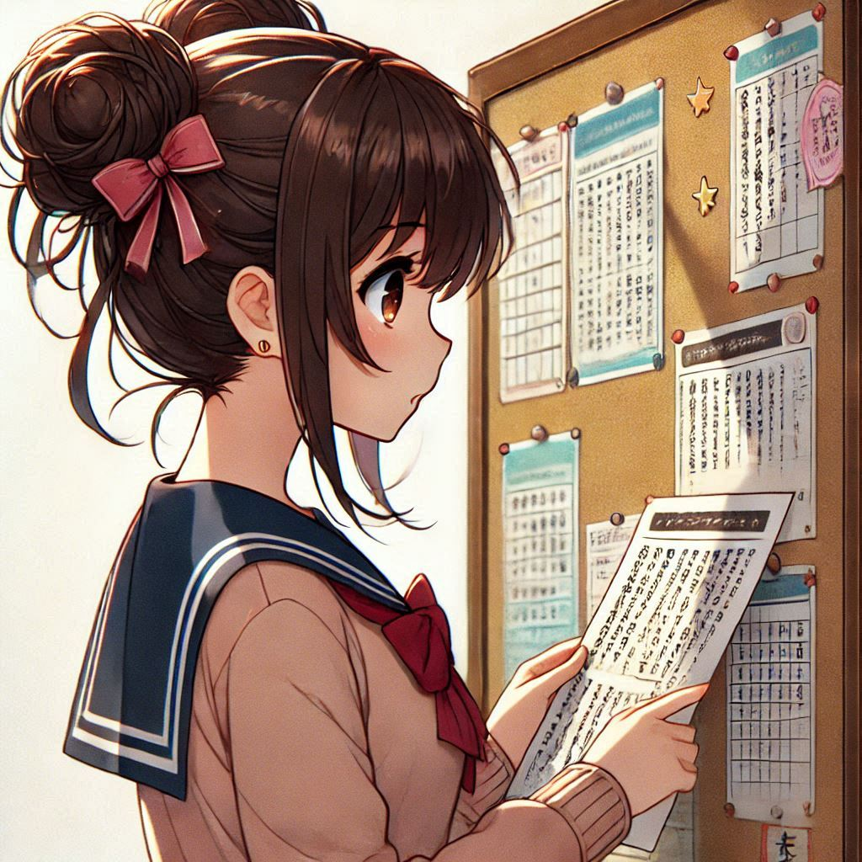
Aim
Notes:
a Japanese anime-style girl with dark brown hair tied up as two top knot,looking at a bulletin board

Slide 6
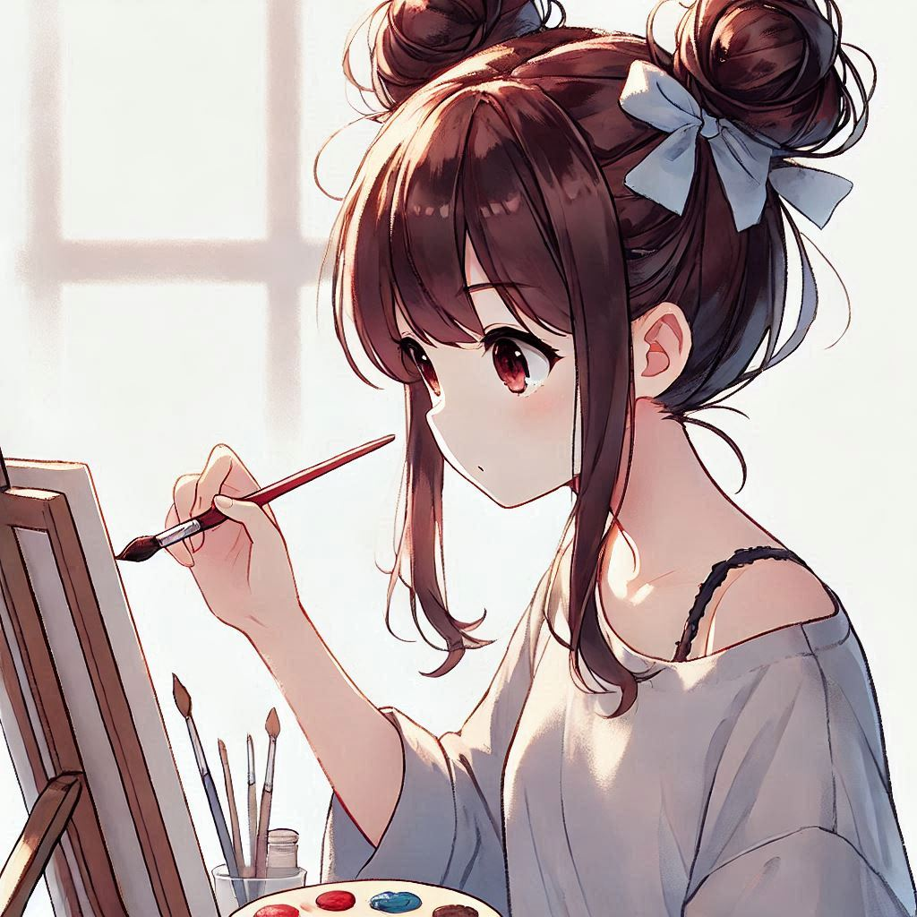
Aim
Notes:
a Japanese anime-style girl with dark brown hair tied up as two top knot, painting someting attentively

Slide 7
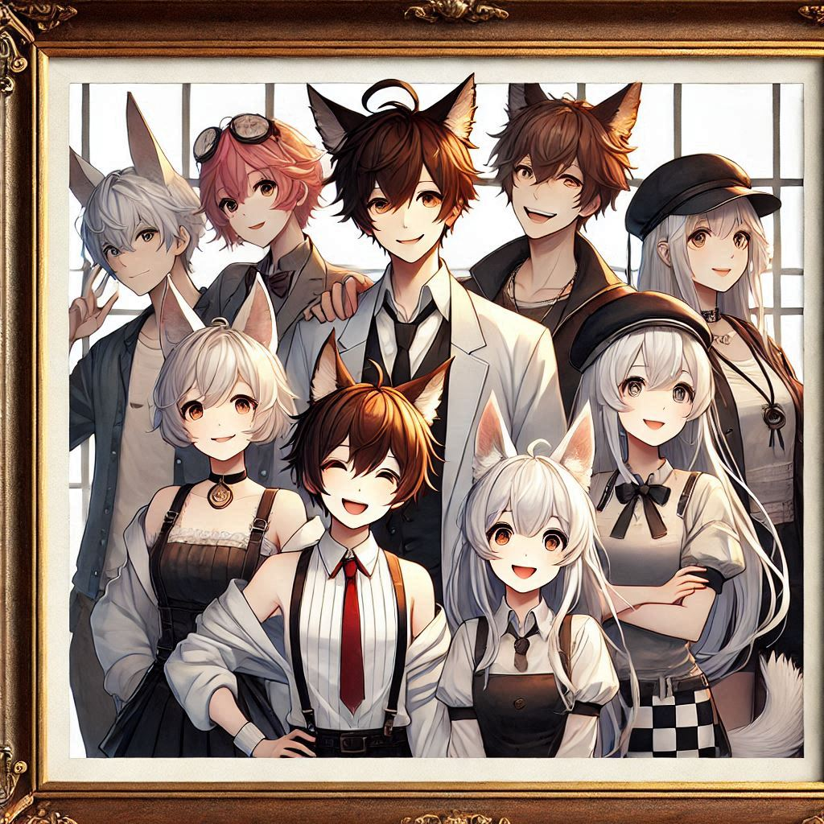
Aim
Notes:
Japanese anime painting with a picture frame featuring some smiling people with animal ears in modern-style clothing, without staring at the camera

Slide 8
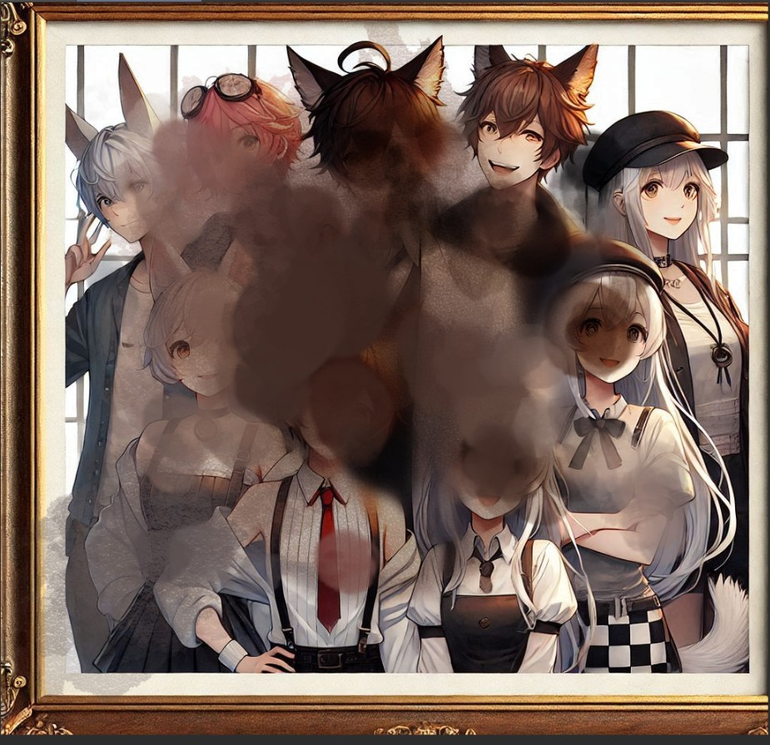
Aim
Notes:
自己加工

Slide 9
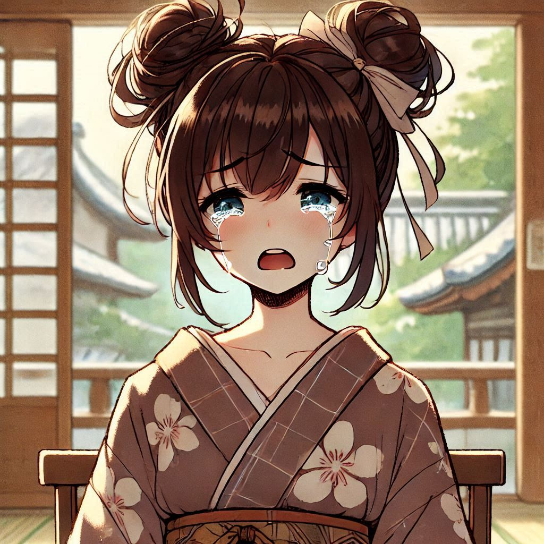
Obstacle
Notes:
a Japanese anime-style girl wearing uniform ,with dark brown hair tied up as two top knot, crying

Slide 10
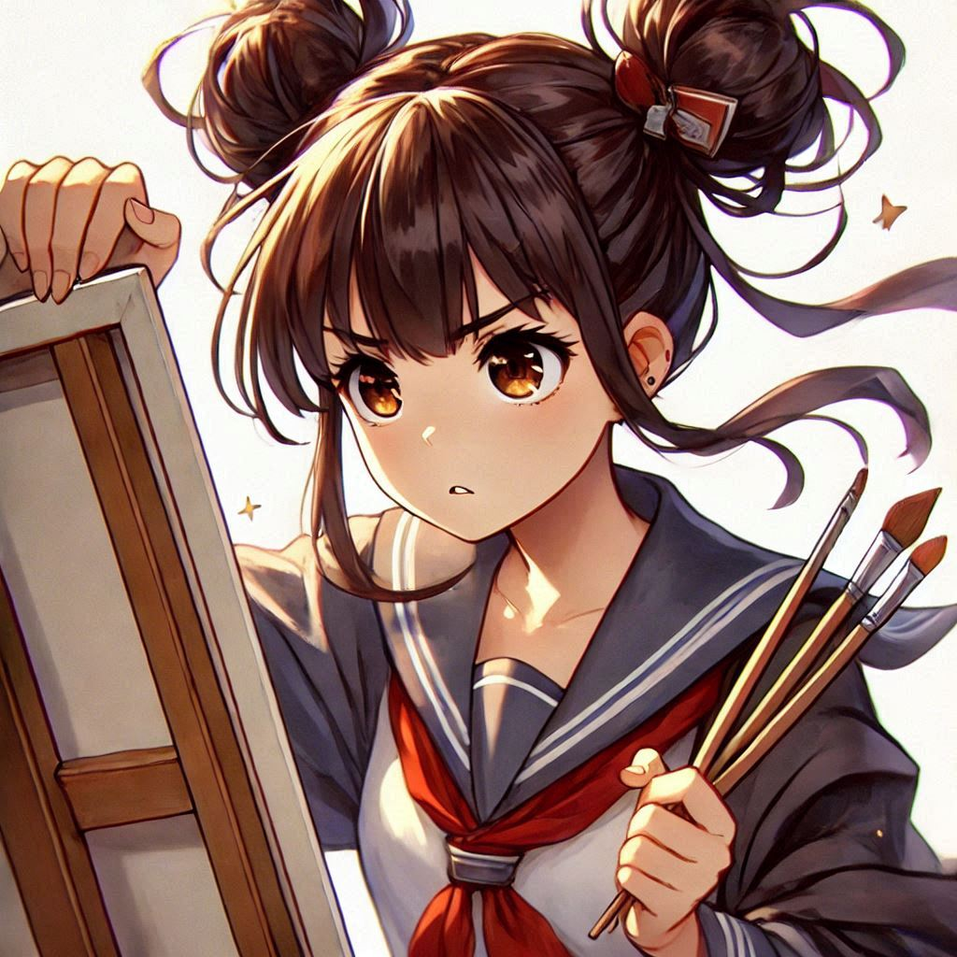
Effort
Notes:
a Japanese anime-style girl with dark brown hair tied up as two top knot, holding tightly onto a painting, looks determined

Slide 11
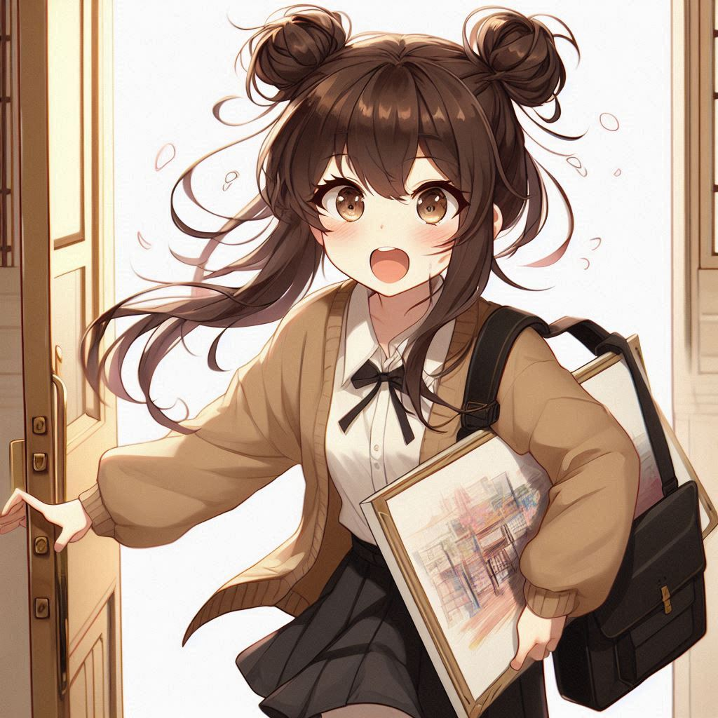
Effort
Notes:
a Japanese anime-style girl with dark brown hair tied up as two top knot, holding a painting and rushing into a venue, panting

Slide 12
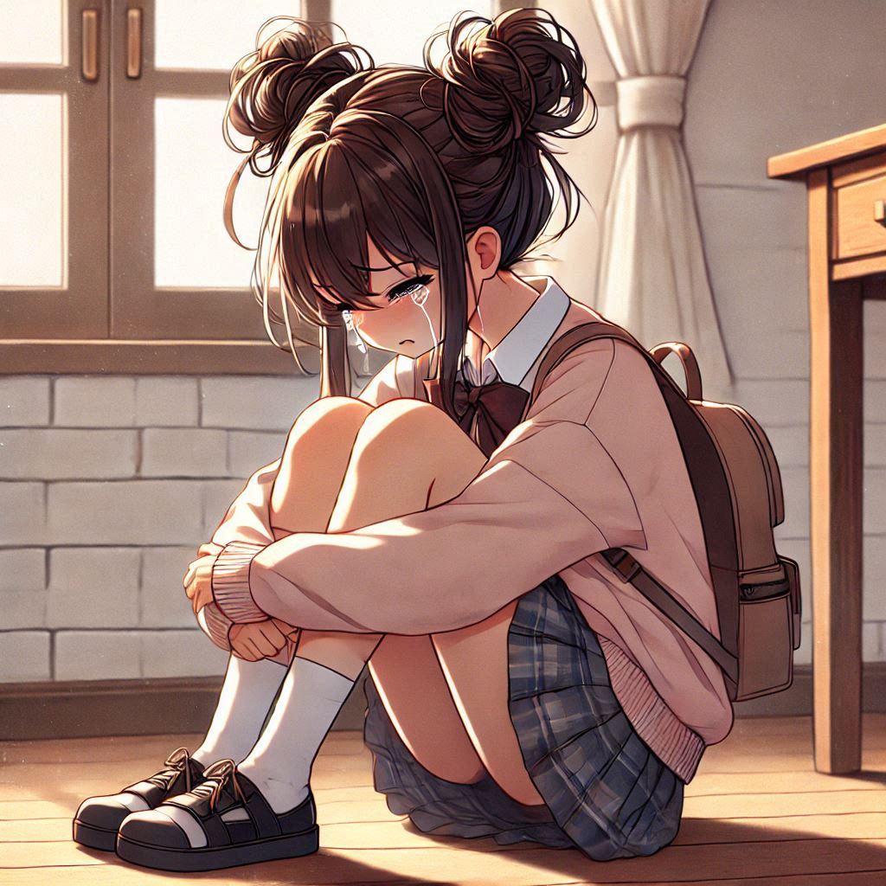
Result
Notes:
a Japanese anime-style girl with dark brown hair tied up as two top knot, sitting on floor and crying

Slide 13

Result
Notes:
a Japanese anime-style girl with dark brown hair tied up in two top knots, lying on floor , too tired to fall asleep

Slide 14
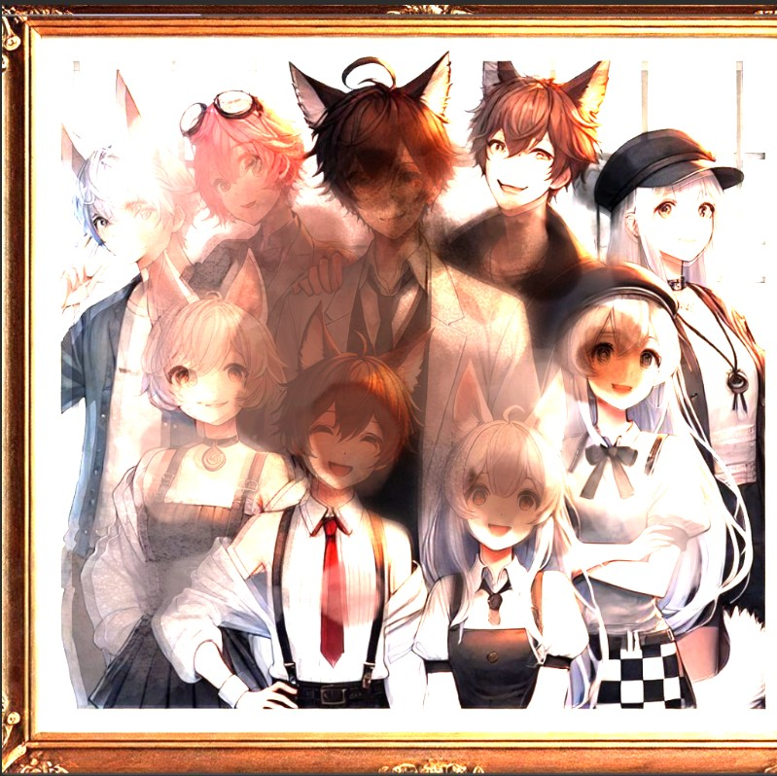
Result
Notes:
自己加工

Slide 15
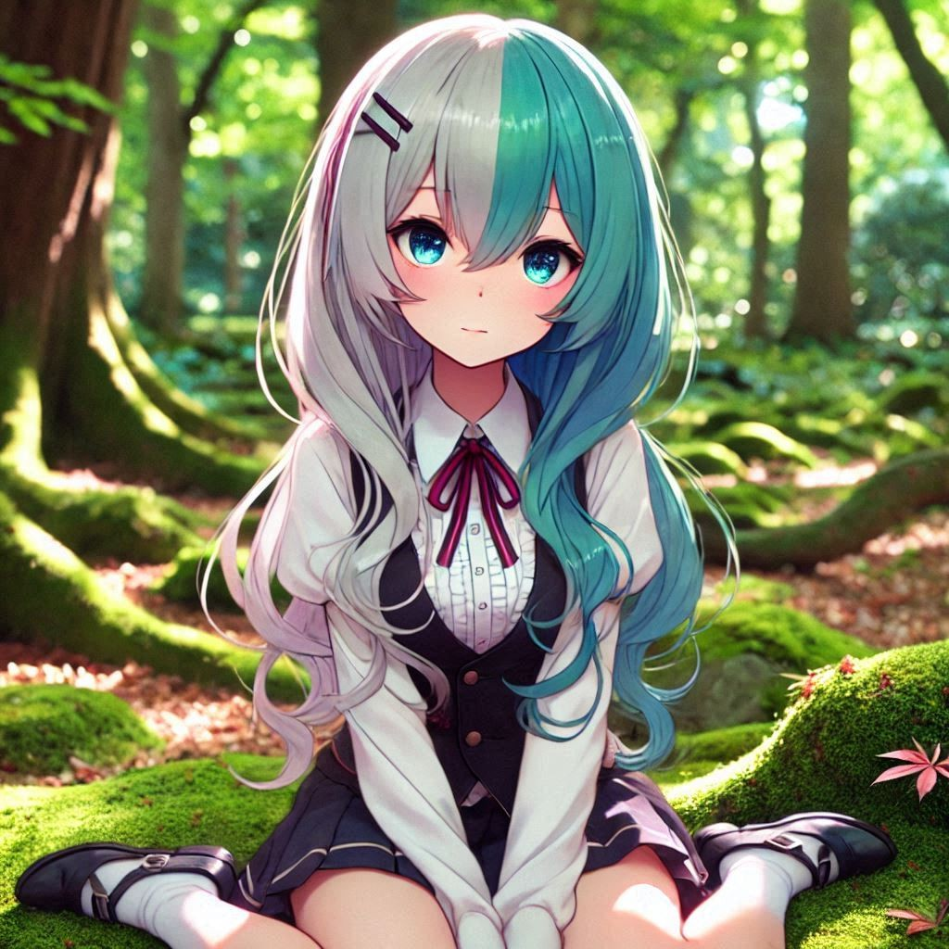
Accident
Notes:
a Japanese anime-style girl with two-toned hair (left side blue-green, right side white), sitting in a forest

Slide 16
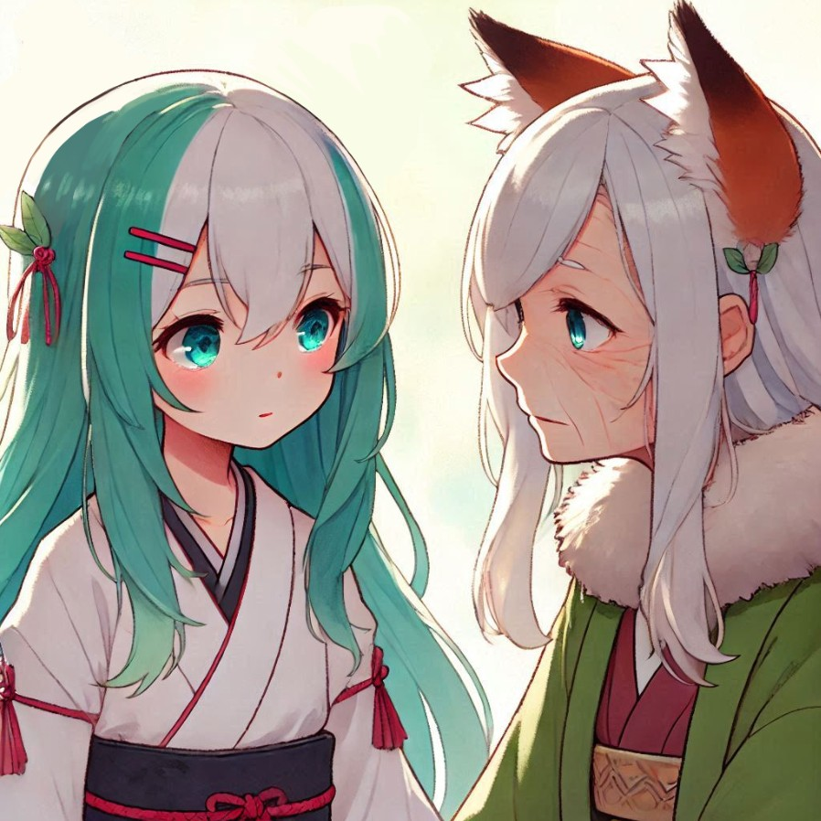
Accident
Notes:
a Japanese anime-style girl with two-toned hair (left side blue-green, right side white), looking at a old woman who has ears of fox

Slide 17
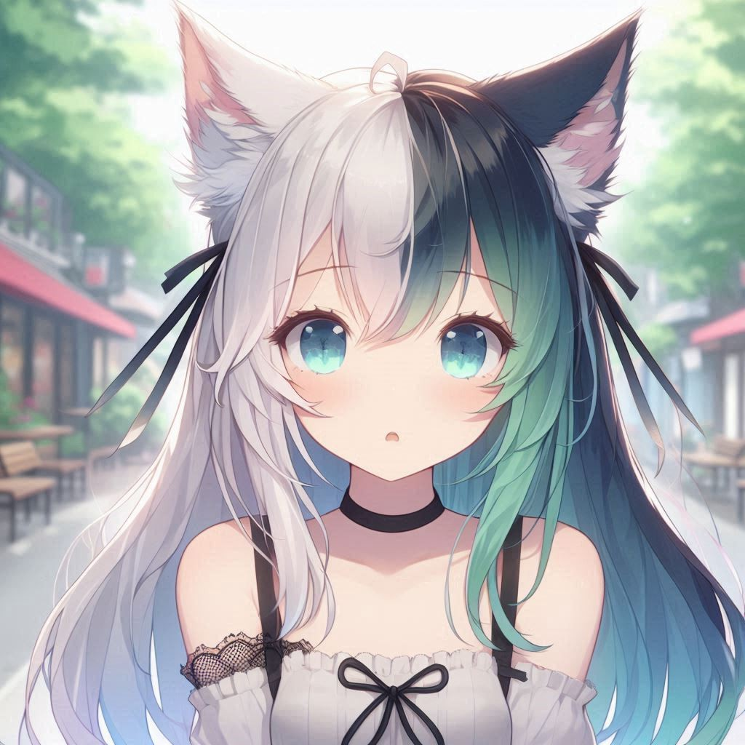
Accident
Notes:
a Japanese anime-style girl with cats ears,having two-toned hair (left side blue-green, right side white)

Slide 18
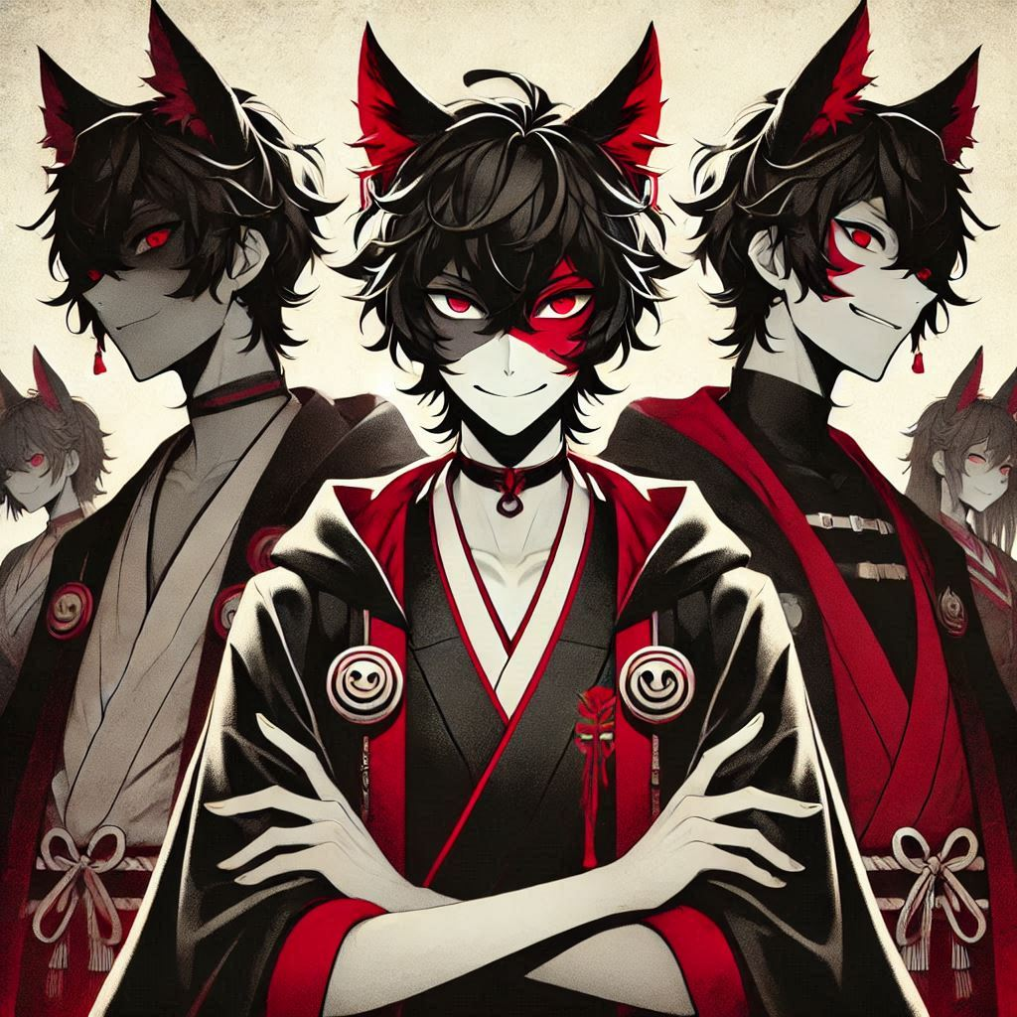
Twist
Notes:
Japanese anime painting featuring some villainous people with animal ears in modern-style clothing, without staring at the camera

Slide 19

Twist
Notes:
a Japanese anime-style image featuring a girl with cat ears, two-toned hair (left side blue-green, right side white), making a fist with a strong-willed expression

Slide 20

Twist
Notes:
a Japanese anime-style girl with cat ears, two-toned hair (left side blue-green, right side white), painting a map with pencil

Slide 21
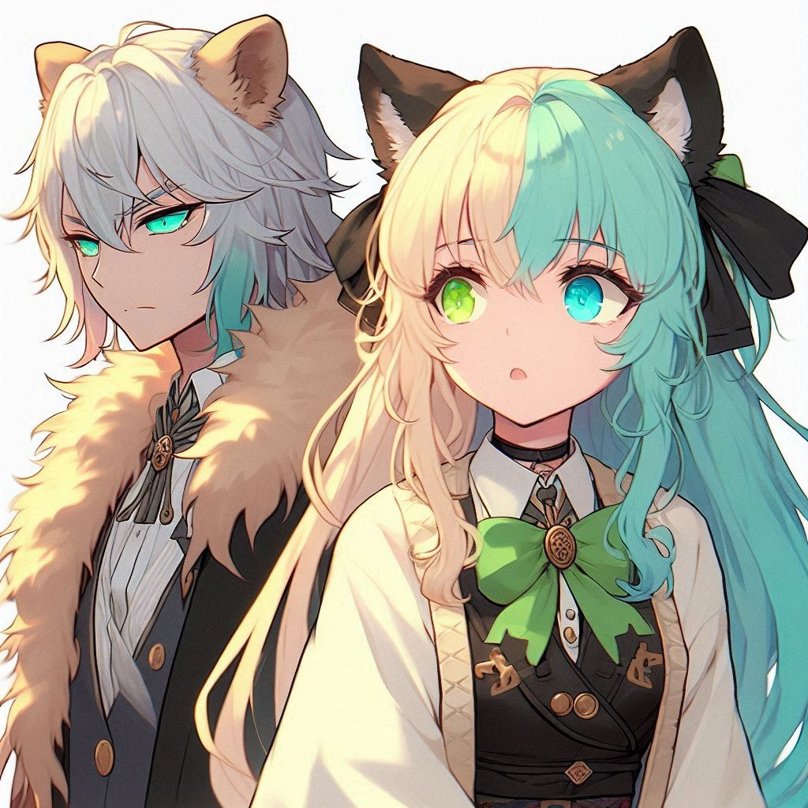
Twist
Notes:
a Japanese anime-style girl with cats ears, having two-toned hair (left side blue-green, right side white),and looking at a taller man who has lion's ears

Slide 22
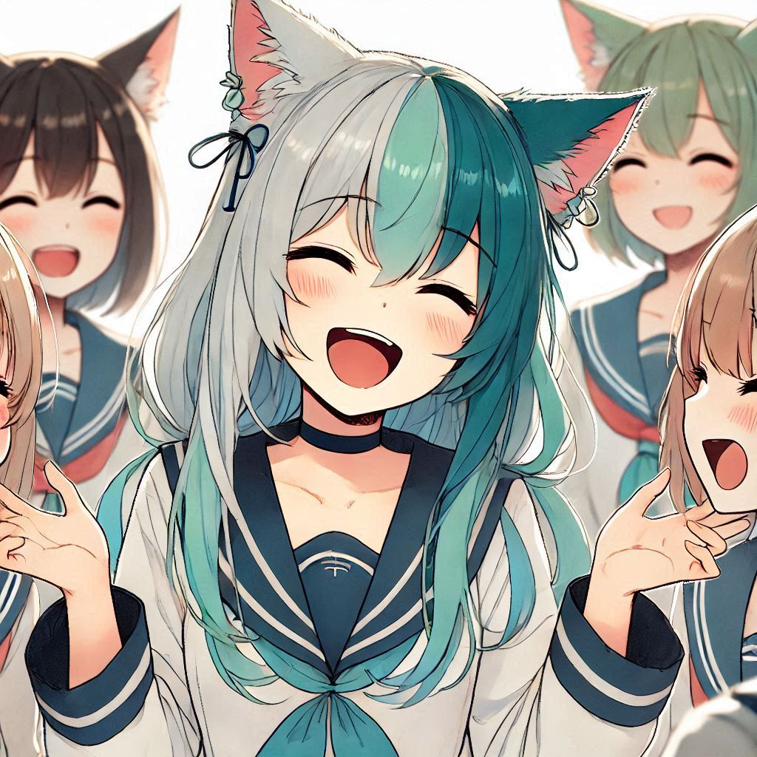
Ending
Notes:
a Japanese anime-style girl with cat ears, two-toned hair (left side blue-green, right side white), happily laughing with some people who have ears of animals

Slide 23

Ending
Notes:
a Japanese anime-style girl with two-toned hair (left side blue-green, right side white)

